Slide 1
RAMPAGE
Technical Post mortem
Phase 1: Procedural Cave Generation

Slide 2
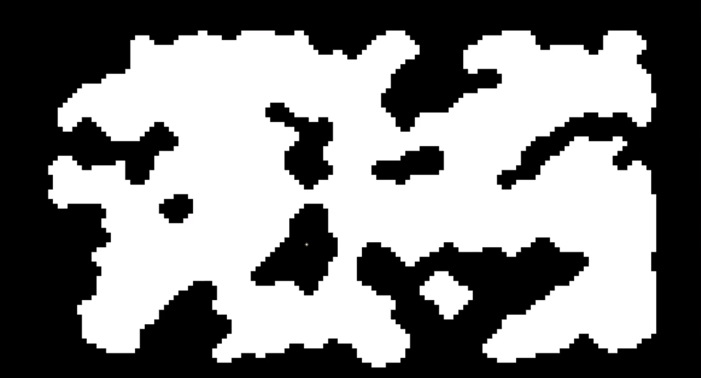
Screenshots
Procedural Cave Generation

Slide 3
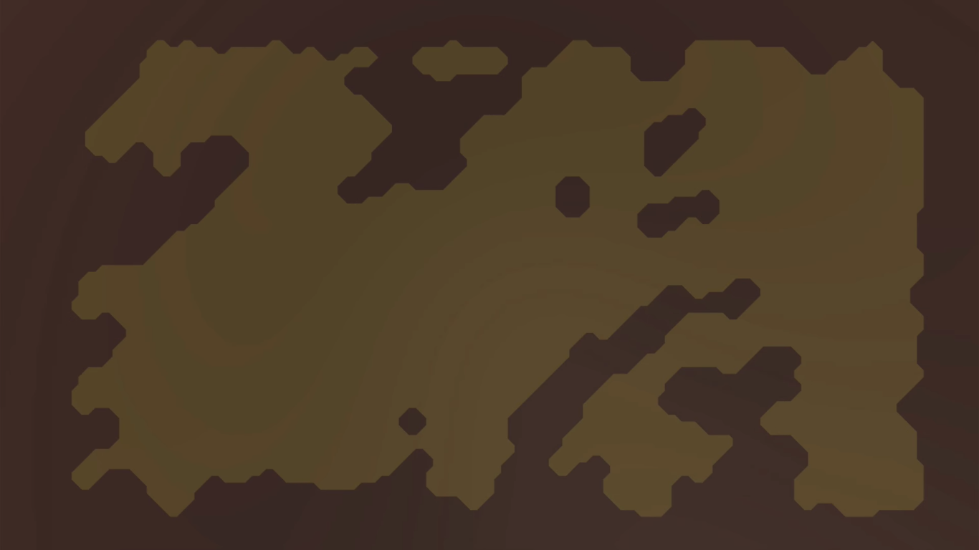
Screenshots
Procedural Cave Generation

Slide 4
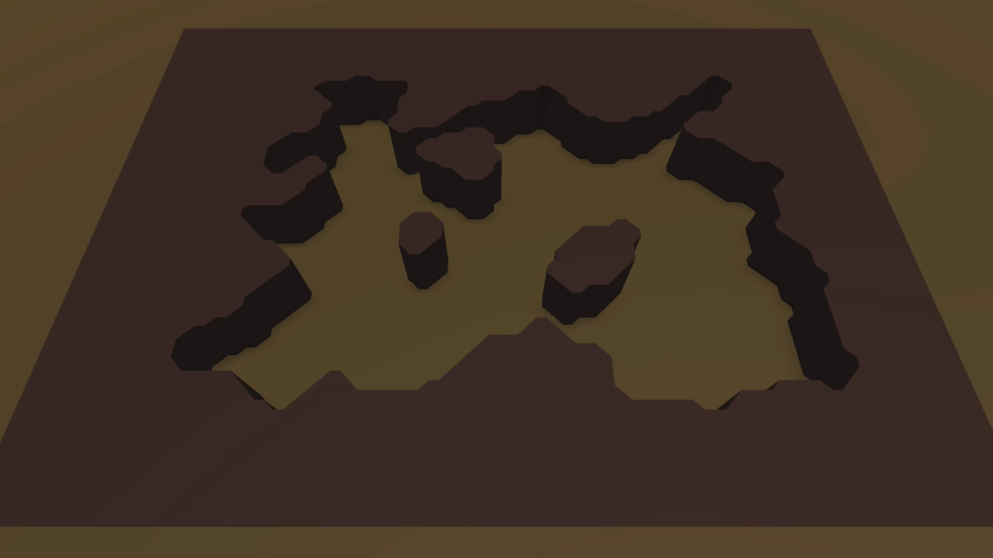
Screenshots
Procedural Cave Generation

Slide 5
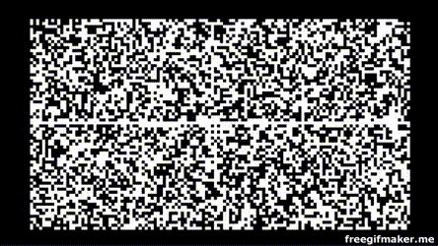
DEMO

Slide 6
3 key parts
Procedural Cave Generation
Generating Content
Walls and Rooms
Polishing and passageways

Slide 7
Part 1: Generating Content

Slide 8
Roadmap
1.1 Cellular Automata
1.2 Marching Squares and Creating Meshes
Part 1: Generating Content

Slide 9
1.1 Cellular Automata
Part 1: Generating Content

Slide 10
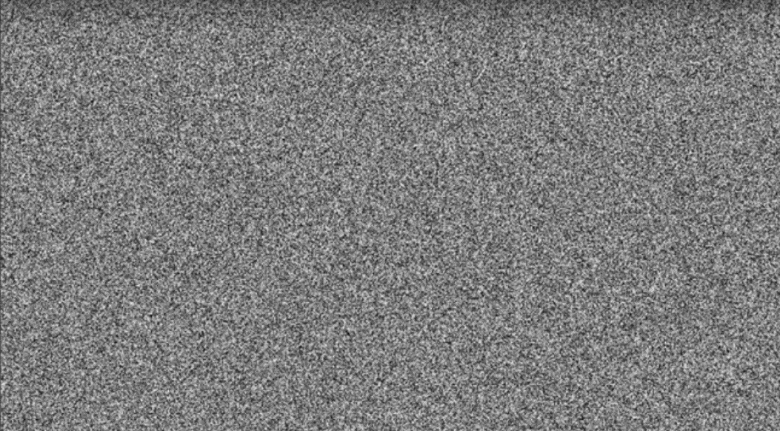
Noise
Regular Noise
Part 1: Generating Content

Slide 11
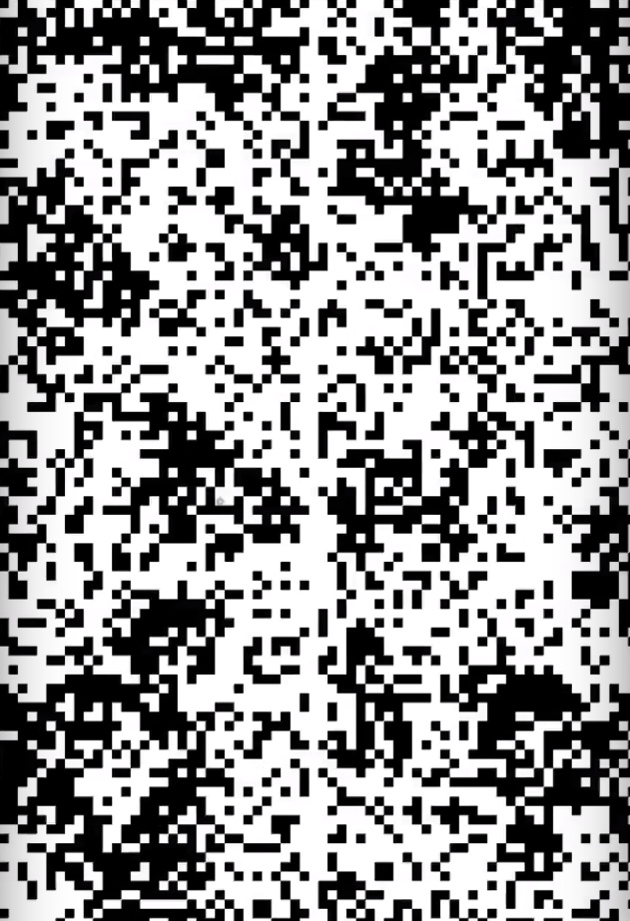
Noise
A 2D binary [0,1] matrix for NoiseMap
map[x, y] = 1 for wall of the cave(Black)
map[x, y] = 0 for empty part (white)
Part 1: Generating Content

Slide 12
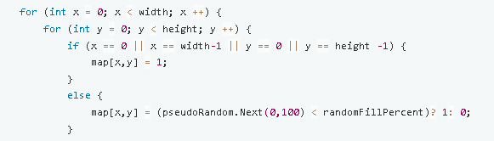
Noise
Part 1: Generating Content

Slide 13
Drawbacks?
Doesn’t look like a cave
Too rough to be used for a game
Part 1: Generating Content

Slide 14
Solution?
Smoothing
We count the neighbouring wall tiles (neighbour position with value 1)
If no. of neighbouring wall tiles > 4, then current position = wall ( i.e. 1)
Else if no. of tiles < 4, it is an empty space ( i.e. 0)
Part 1: Generating Content

Slide 15
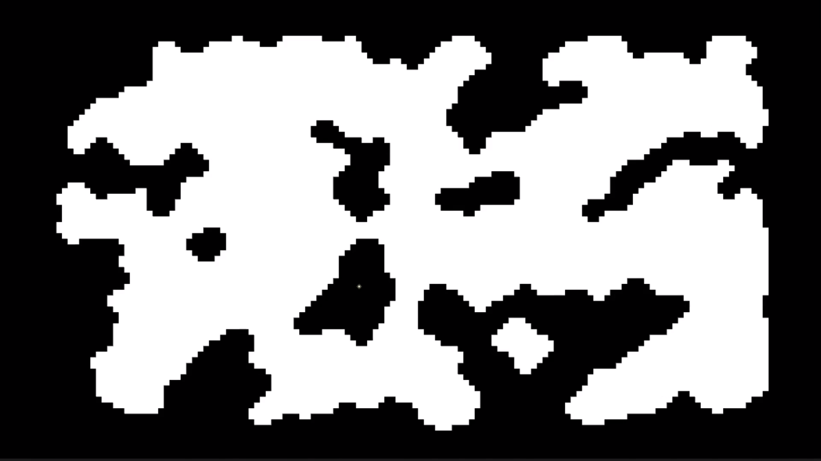
Result
Part 1: Generating Content

Slide 16
1.2 Marching Squares and Mesh Generation
Part 1: Generating Content

Slide 17
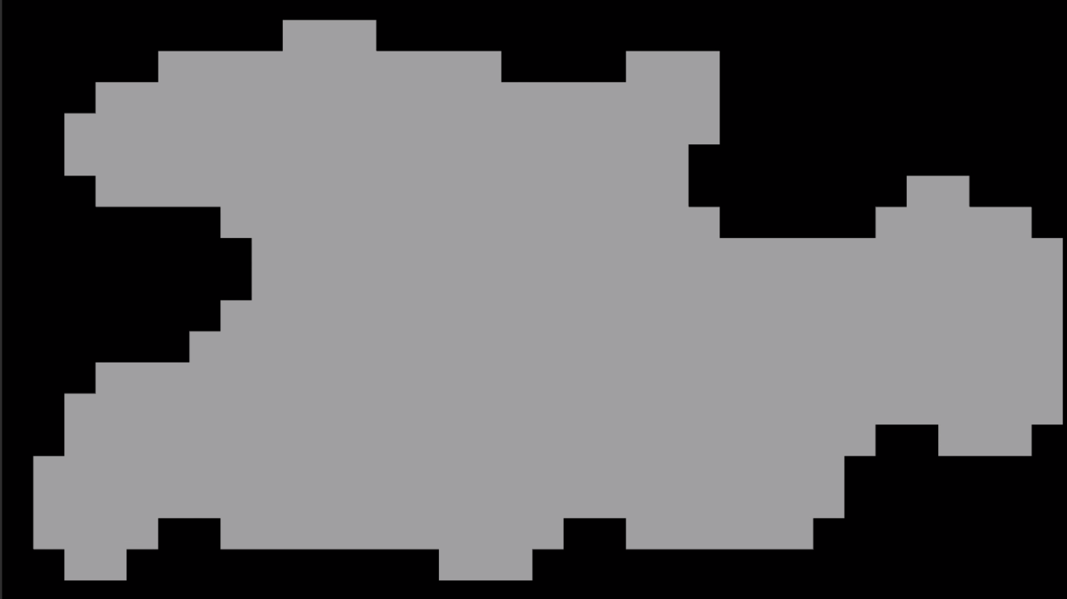
To generate a mesh from this
Part 1: Generating Content

Slide 18
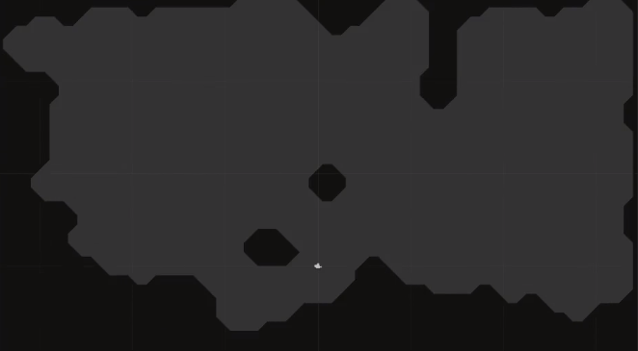
To this
Part 1: Generating Content

Slide 19
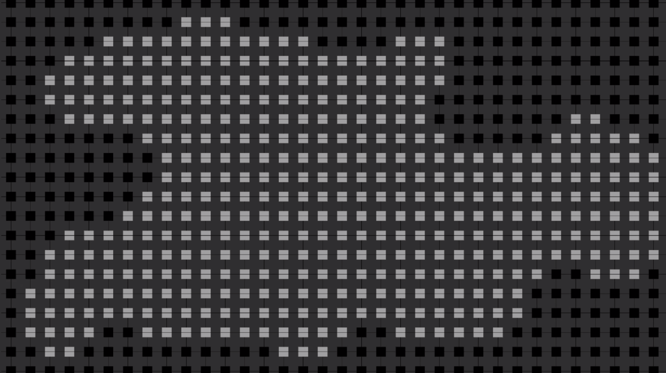
We need to make Square Maps like this
Part 1: Generating Content

Slide 20
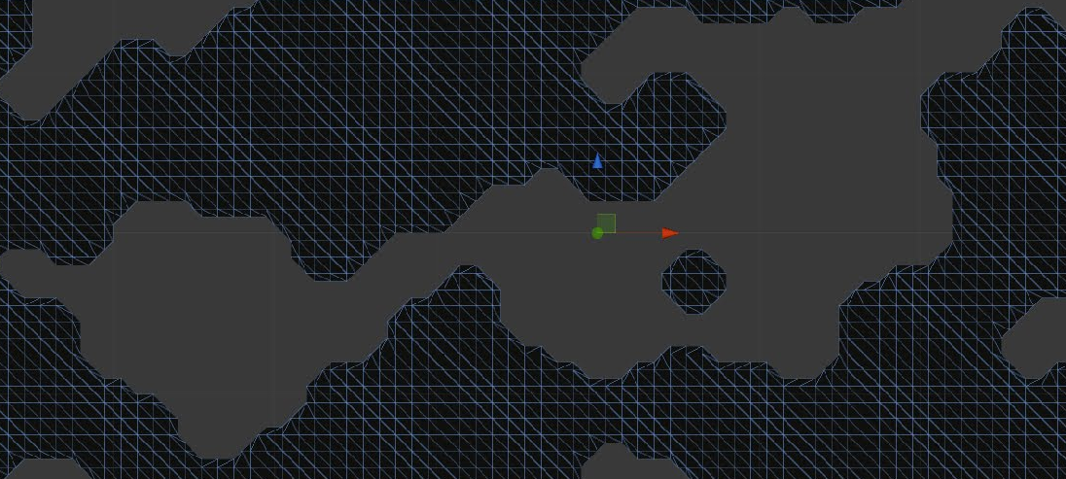
Meshes are made of Triangles
Part 1: Generating Content

Slide 21
Mesh Triangles are generated by Square Maps
Part 1: Generating Content

Slide 22
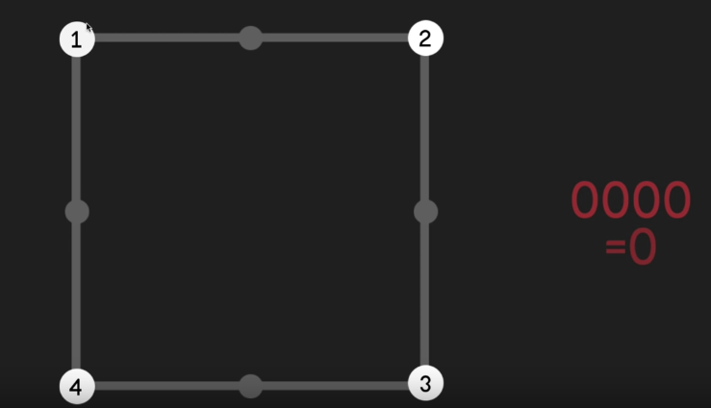
A Square Map consists of such squares
Part 1: Generating Content

Slide 23
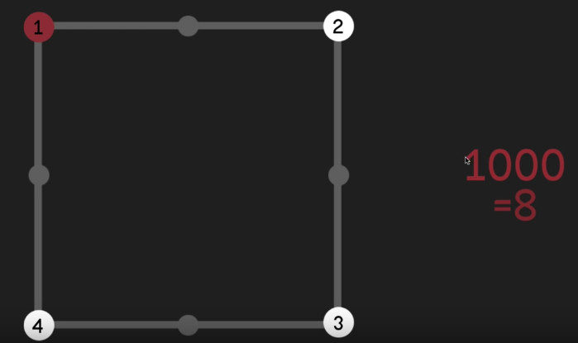
Activated corners represented by 4-bit binary numbers
Part 1: Generating Content

Slide 24
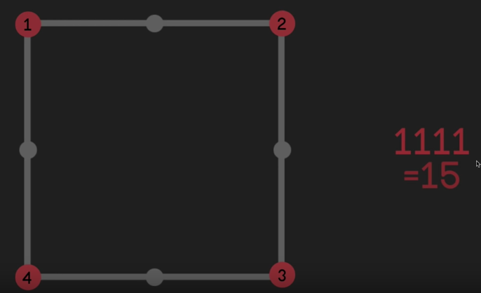
Corners also called Control Nodes
Part 1: Generating Content

Slide 25
Why?
Part 1: Generating Content

Slide 26
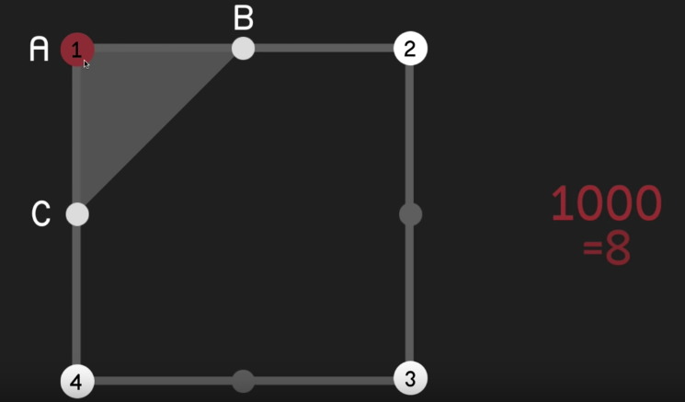
Control Nodes used to create Triangles for meshes like this
Part 1: Generating Content

Slide 27
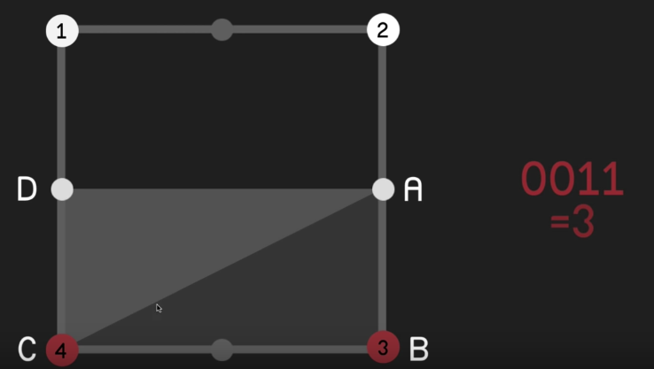
Various configurations to generate Triangles
Part 1: Generating Content

Slide 28
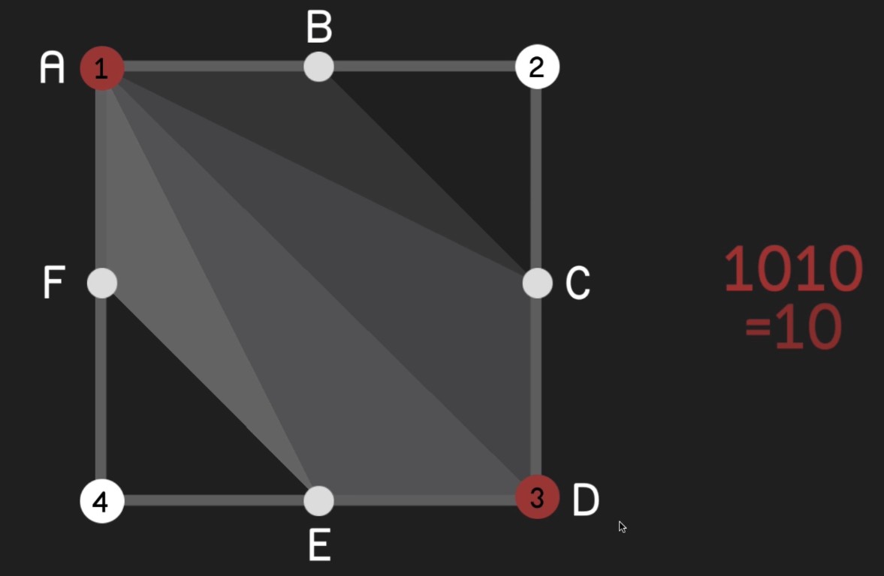
Various configurations to generate Triangles
Part 1: Generating Content

Slide 29
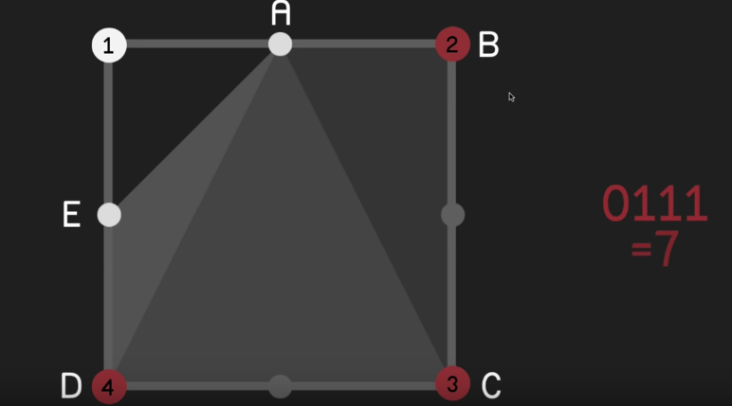
Various configurations to generate Triangles
Part 1: Generating Content

Slide 30
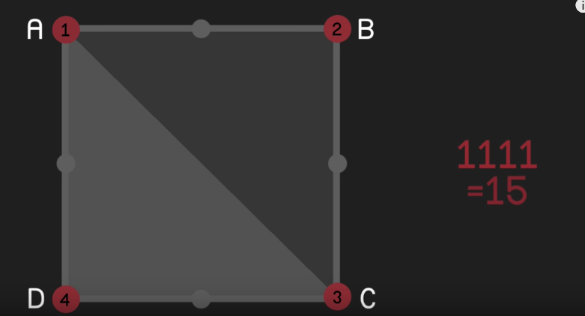
Various configurations to generate Triangles
Part 1: Generating Content

Slide 31
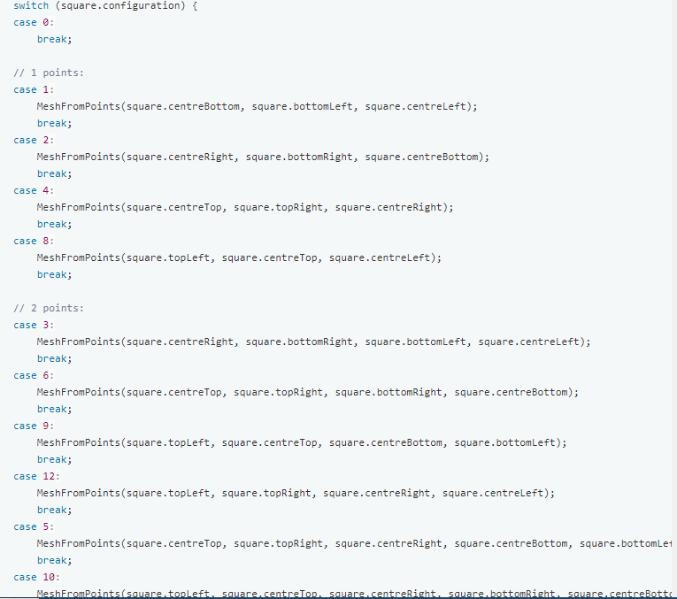
Creating Triangles using Squares
Part 1: Generating Content

Slide 32
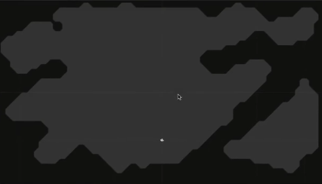
Result
Part 1: Generating Content

Slide 33
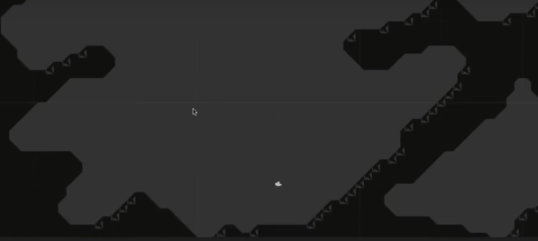
If nodes are assigned to triangles in any order other than clockwise
Part 1: Generating Content

Slide 34
Part 2: Walls and Rooms

Slide 35
Roadmap
2.1 3D Walls
2.2 Detecting Regions
2.3 Connecting Rooms
Part 2: Walls and Rooms

Slide 36
2.1 3D Walls
Part 2: Walls and Rooms

Slide 37
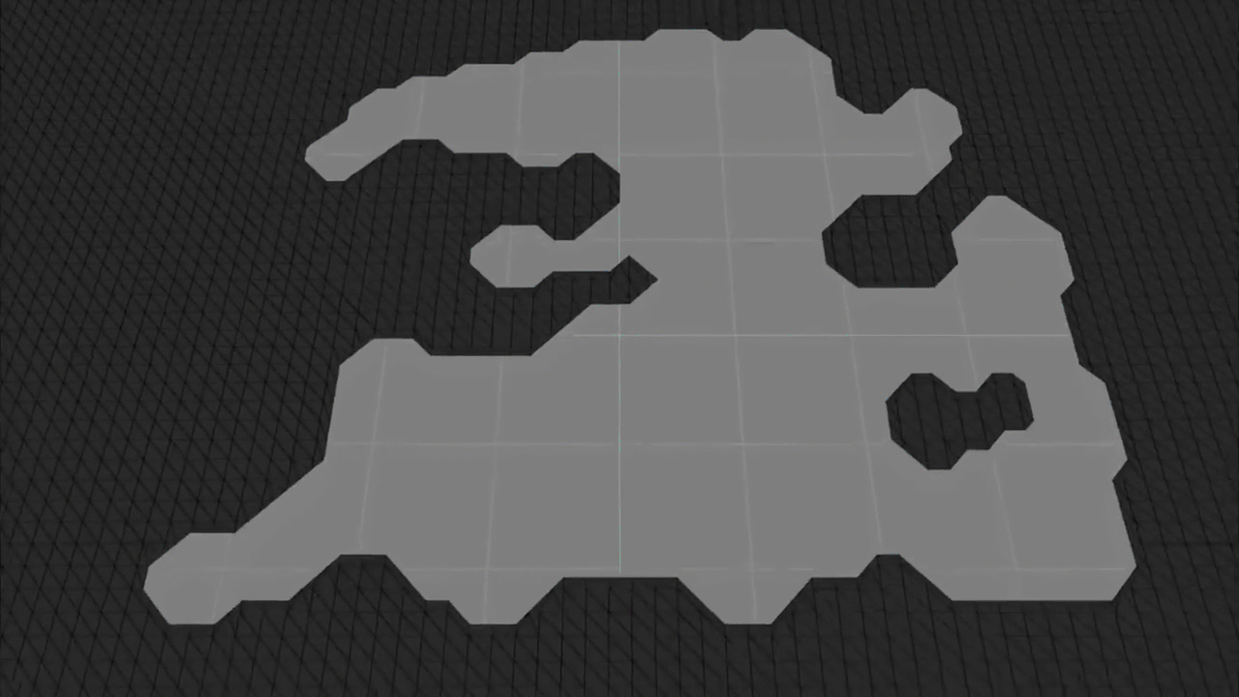
Generating 3D mesh for walls around open areas
Part 2: Walls and Rooms

Slide 38
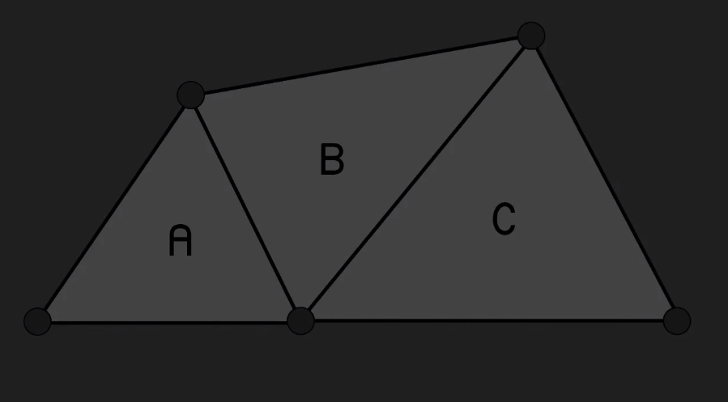
Concept of Outline Edges
Part 2: Walls and Rooms

Slide 39
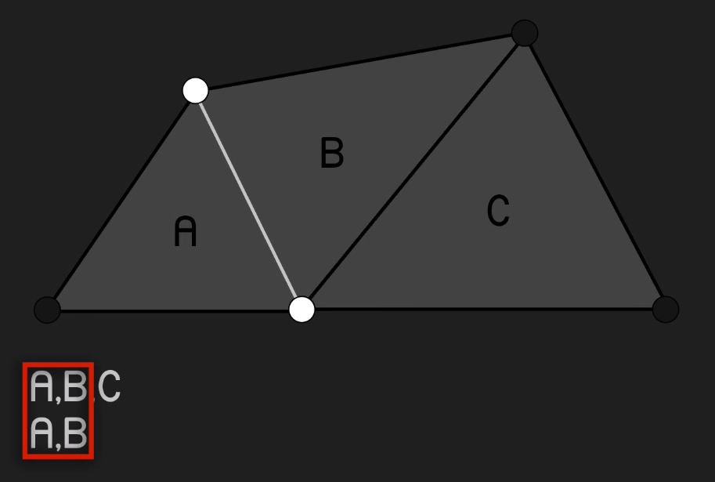
Concept of Outline Edges
Part 2: Walls and Rooms

Slide 40
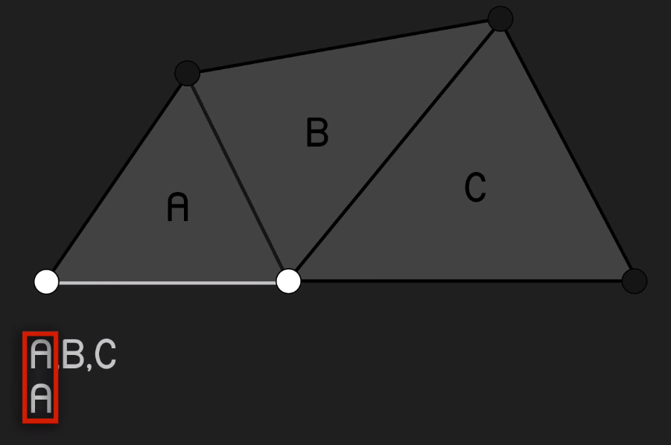
An Outline Edge
Part 2: Walls and Rooms

Slide 41
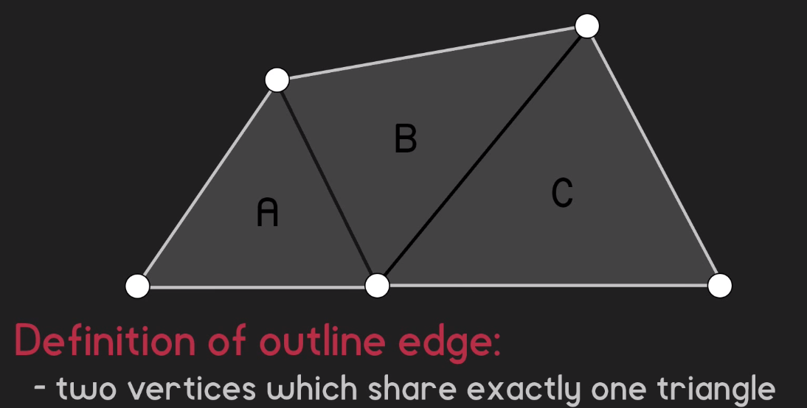
How to Detect an Outline Edge
Part 2: Walls and Rooms

Slide 42
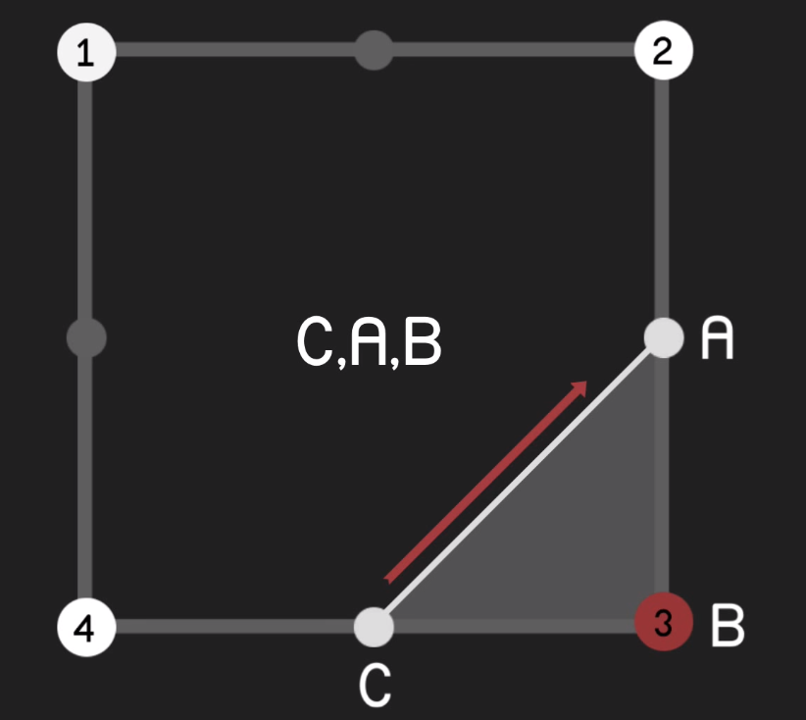
Direction of Outline Edges
Part 2: Walls and Rooms

Slide 43
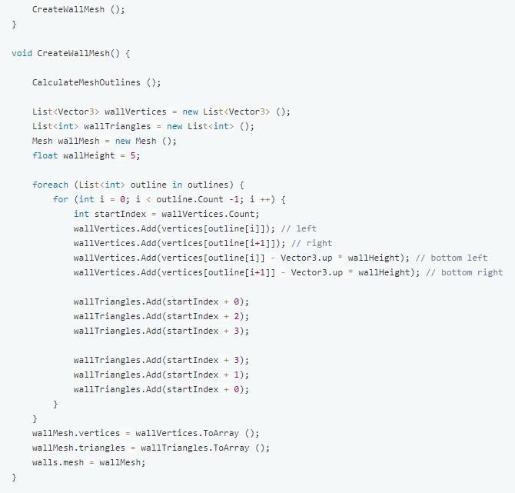
Creating Wall Mesh
Part 2: Walls and Rooms

Slide 44
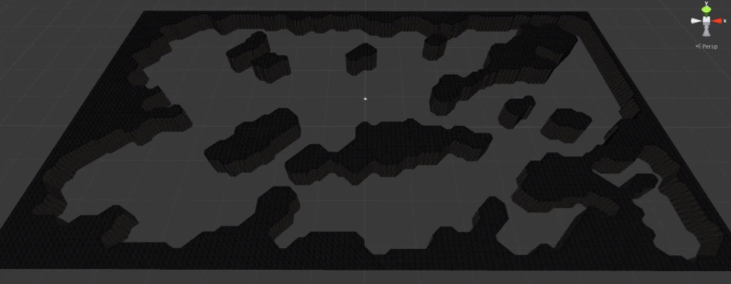
Final Result
Part 2: Walls and Rooms

Slide 45
2.2 Detecting Regions
Part 2: Walls and Rooms

Slide 46
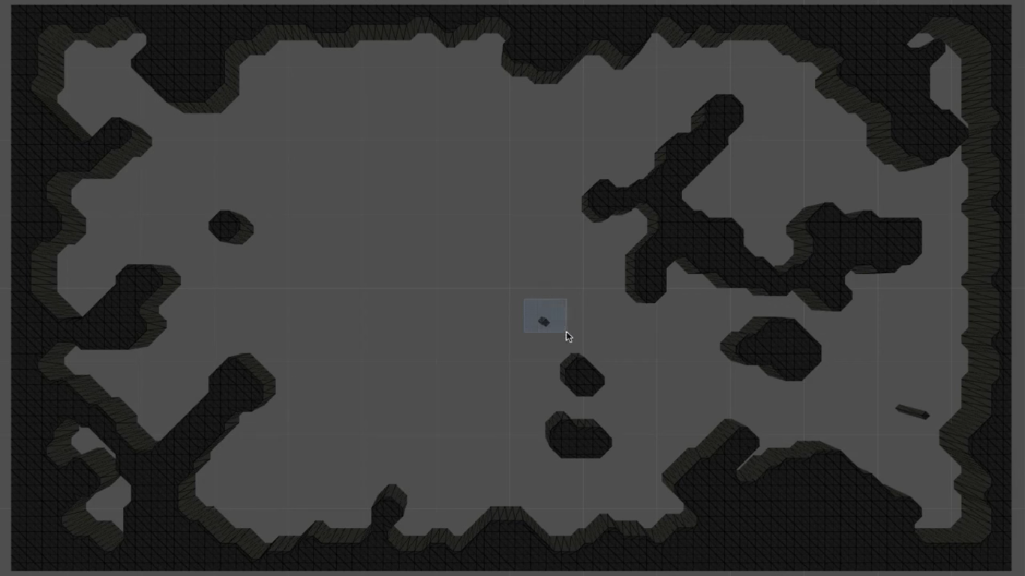
Issue 1 : Small island of wall tiles
Part 2: Walls and Rooms

Slide 47
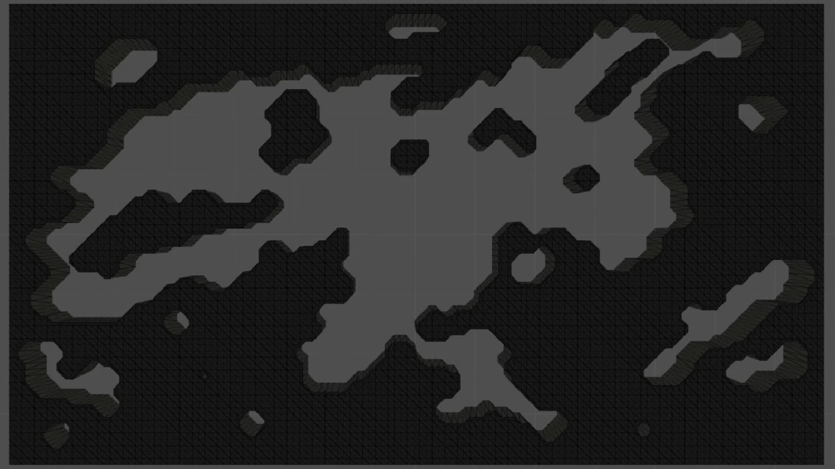
Issue 2 : Small isolated rooms
Part 2: Walls and Rooms

Slide 48
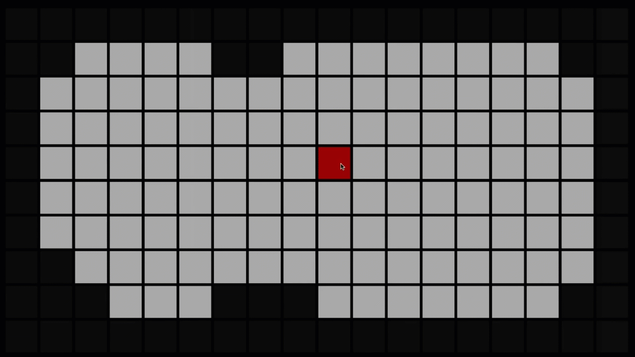
To Do :
Detect Wall and Room regions using Flood-Fill Algorithm
Part 2: Walls and Rooms

Slide 49
List<Coordinate> getRegionTiles(int startX,int startY){
//employs flood-fill algorithm to return a list of tiles of a type(1 for wall and 0 for room)
//starting from a tile, iteratively checks its neighbors and adds tiles to a list
}
List<List<Coordinates>> getRegions(int tileType){
//iterate over all the tiles in the map and returns the list of all regions of the tileType
}
Part 2: Walls and Rooms

Slide 50
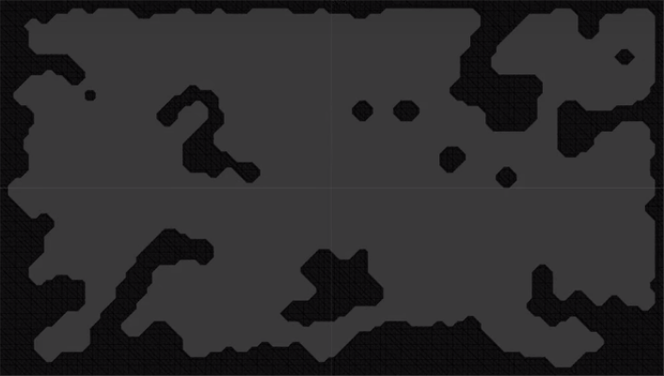
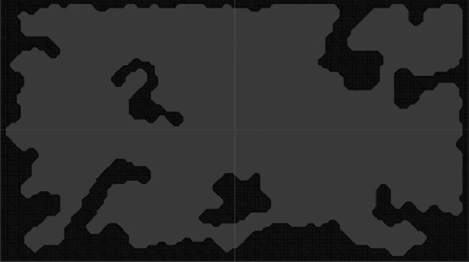
Now :
Remove the wall region whose size falls below a certain threshold value
Part 2: Walls and Rooms

Slide 51
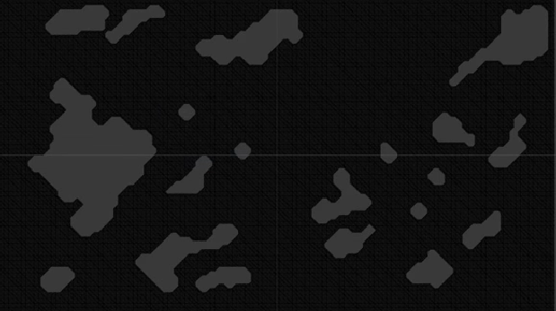
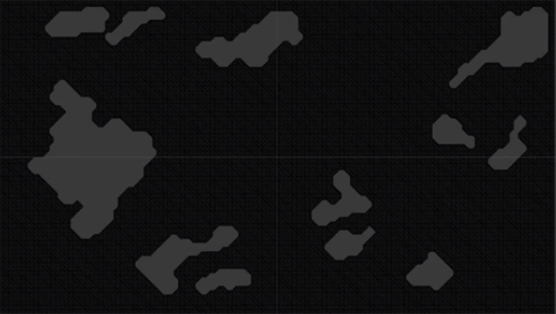
Fill the room regions whose size falls below a certain threshold value
Part 2: Walls and Rooms

Slide 52
processMap(){
//to remove islands of wall tiles
List<List<Coordinates>> list = getRegions(1)
for each List<Coordinates> wallRegion in list
if wallRegion.size() < threshold_value
mark all tiles in the list as 0 to make them room tiles
//to fill isolated rooms up
List<List<Coordinates>> list = getRegions(0)
for each List<Coordinates> roomRegion in list
if roomRegion.size() < threshold_value
mark all tiles in the list as 1 to make them wall tiles
}
Part 2: Walls and Rooms

Slide 53
2.2 Connecting Rooms
Part 2: Walls and Rooms

Slide 54
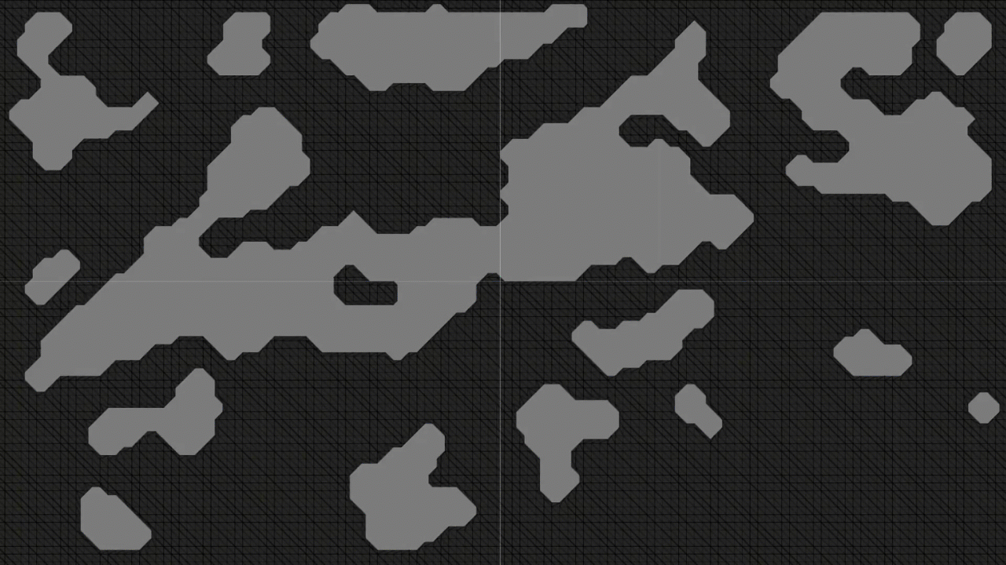
Connect the rooms with passageways
Part 2: Walls and Rooms

Slide 55
Connect the rooms based on proximity i.e. a room will always be connected to its nearest possible room
connectClosestRooms(List<Room> allRooms){
//for each room check proximity with each other room
//calculate distance between edge tiles of two rooms
//for nearest the nearest room call
createPassage(roomA,roomB,bestTileA,bestTileB)
}
Part 2: Walls and Rooms

Slide 56
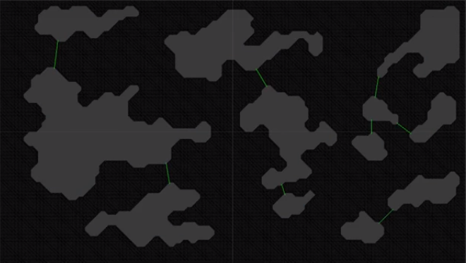
createPassage(roomA,roomB,bestTileA,bestTileB){
Room.connect(roomA,roomB)
Debug.drawLine(tileA,tileB,Color.green)
}
Part 2: Walls and Rooms

Slide 57
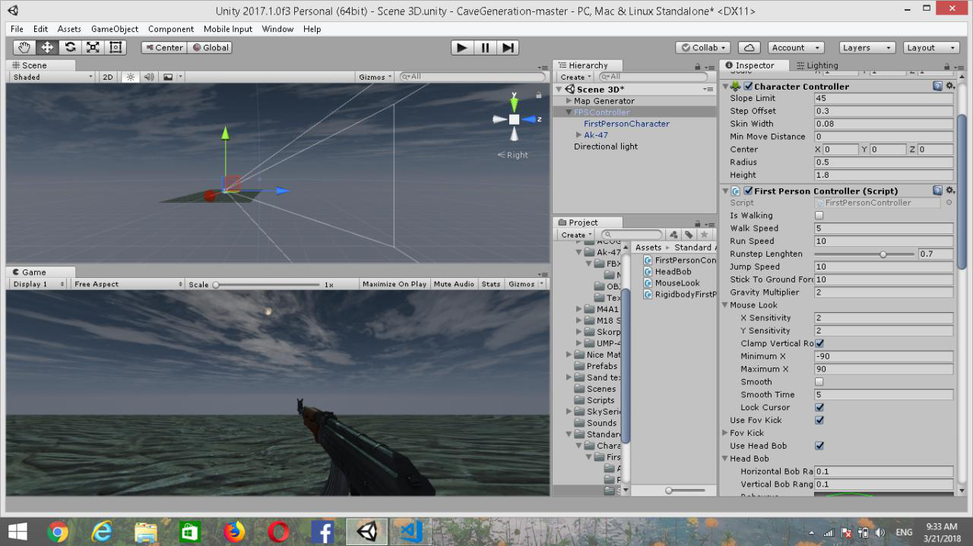
Future Prospects:
- AI will be used to make enemies navigate towards the player
- Player controls will be added, along with other features, like weapons, etc.

Slide 58
Behind the Scenes
Team members:
Debayan De
Rohit Das
Rudra Nil Basu
Sumitro Chowdhury
Game Engine:
- Unity 3D
Mentored by:
- Rupali Patua

Slide 59
Thank You

